Slide 1
Acoustic Beam Forming Array
By: Angelo Charbonnier

Slide 2
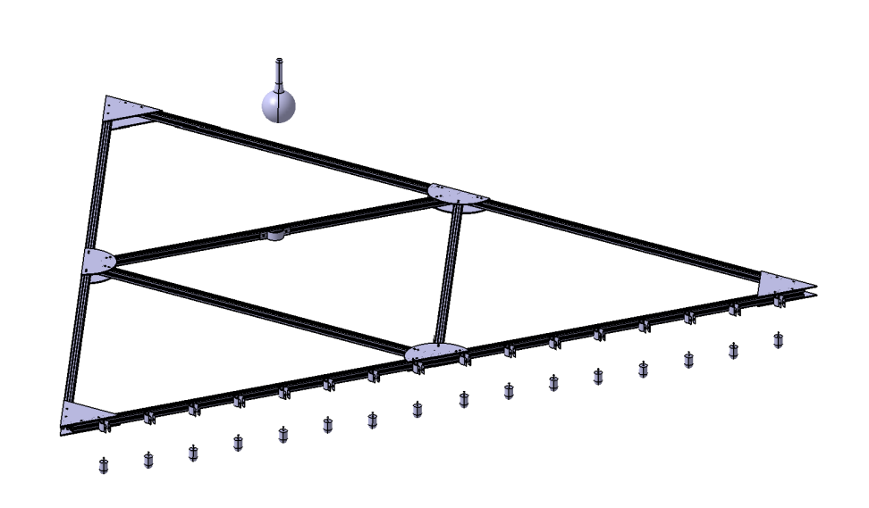
Project Introduction
Current Sonar Systems can be classified as either side scanning or bottom penetrating
Side scanning systems sweep a large area below them to the sea bed.
Bottom penetrating systems use a narrow more powerful beam to penetrate the sea bed.
Our system will use beam forming to combined the two systems so that a large area beneath the array can be swept with penetrating capabilities.

Slide 3
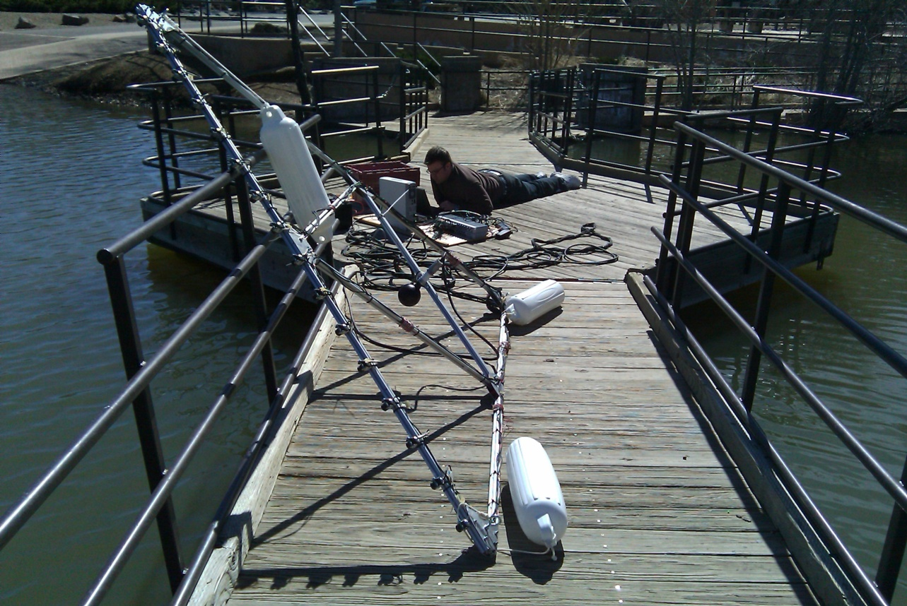
Current Tests
Test Data was created for simulation with beam forming techniques.
Testing of the array is being performed at a local lake and data is being obtained for analysis with beam forming.

Slide 4
Further Analysis
Power analysis is being performed so that the expected levels of acoustic power is being achieved based on our signal and input electrical power
Calibration of all 16 of the systems hydrophones needs to be complete so that all the input levels are correctly being measured.
  Calibration is achieved through a direct comparison of a reference hydrophone’s recorded data to our own

Slide 5
Beam Forming
We record delayed sound waves from sixteen different hydrophones.
For each place the sound wave hits, a delayed signal comes back to each hydrophone with some delay
True signals have noise thus the delay is not easy to see
Figure :Sample delayed sound waves from 9 hydrophones
Figure : Sample Signal with noise

Slide 6
Beam Forming
Method
Each recording has a specific norm
Summing these signals creates a larger norm
By sampling the summations we generate a plot similar to the one shown
The peak is the correct delay because it has the max norm
We now know that the recorded object is located at -4 radians below the source

